Slide 1
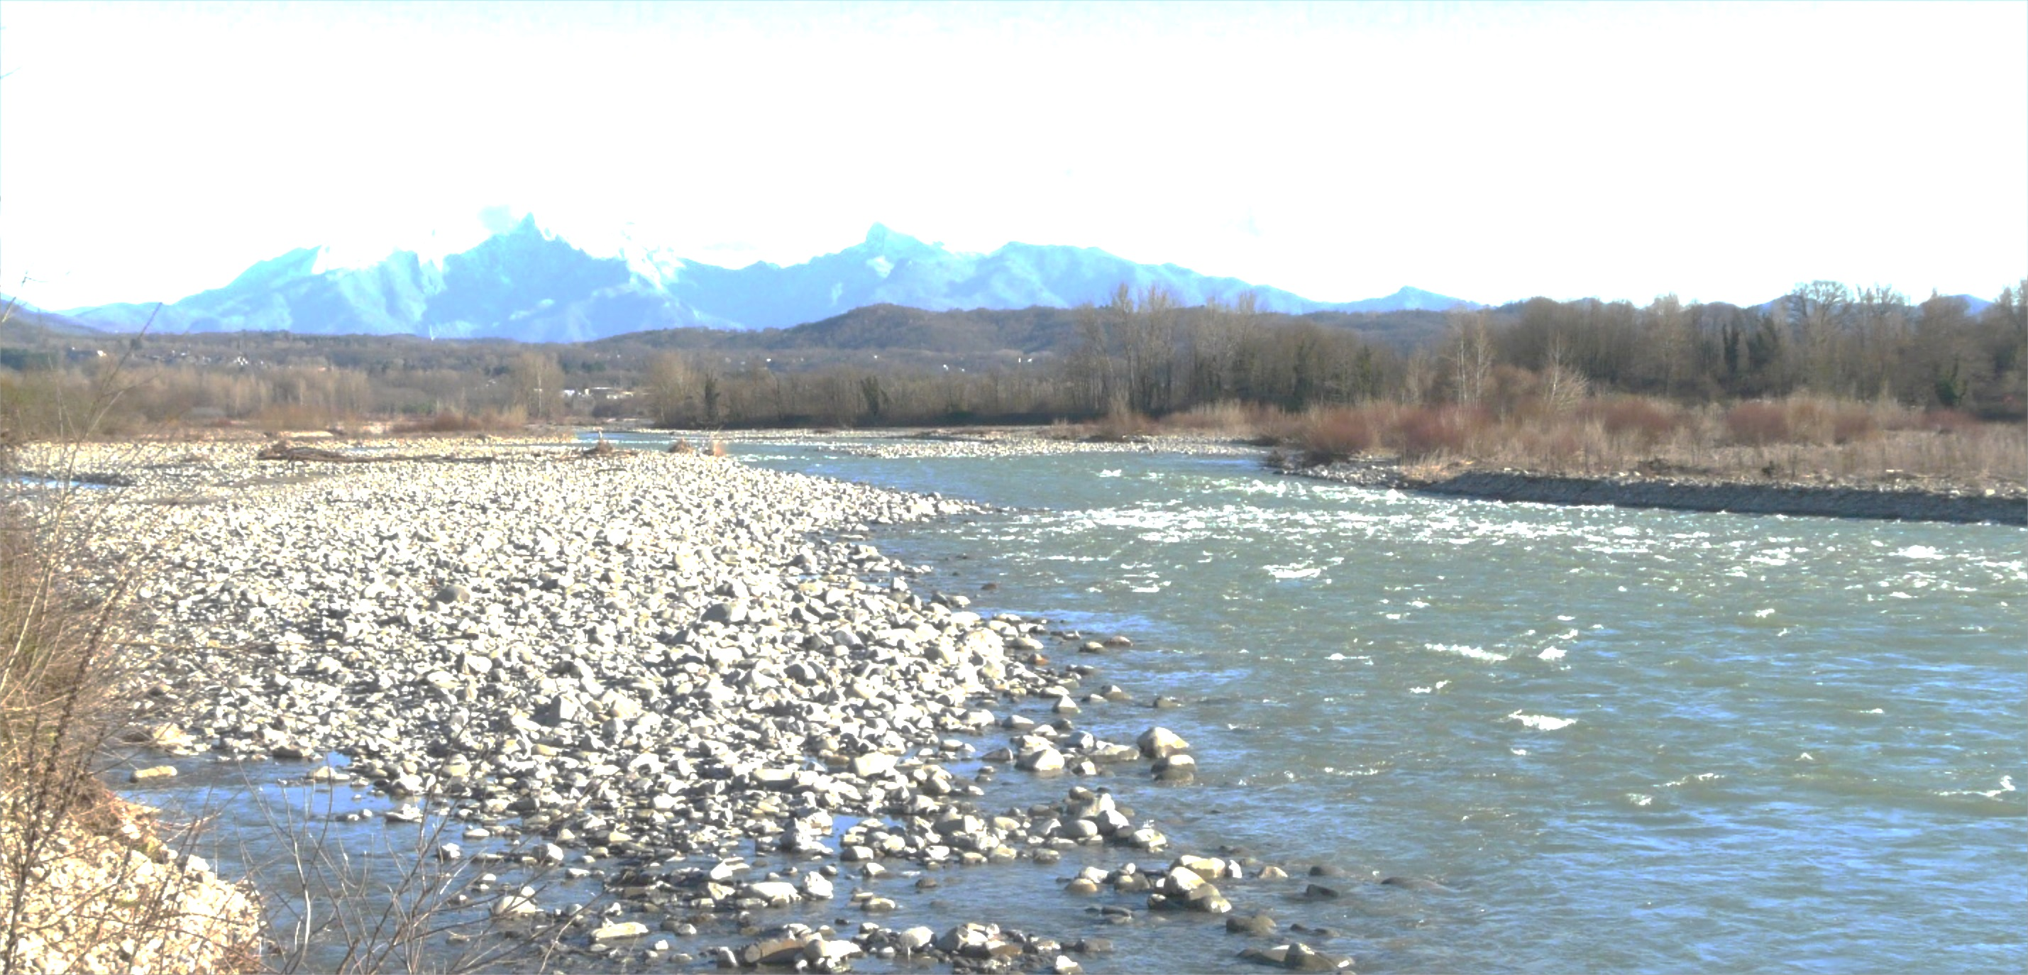
Why is hydromorphology important
Functioning of physical processes spontaneously promotes ecosystem diversity and functioning.
Notes:
According to the WFD, hydromorphology contributes to the characterization and assessment of the status of water bodies, i.e. it concerns their physical status. The natural functioning of physical processes spontaneously promotes ecosystem diversity and functioning. Physical processes and structures are relevant to the provision of habitats to support the entire life cycle of organisms including refuge, feeding, spawning habitats, etc. Thus, an understanding of hydromorphology is essential for identifying degraded segments and reaches of rivers and for developing sustainable restoration approaches consistent with hydromorphological functioning from catchment to reach scales.

Slide 2
What kind of methods should be used to assess hydromorphology
(from Belletti et al., 2015)
(from Belletti et al., 2015)
PH: Physical habitat assessment
RH: Riparian habitat assessment
M: Morphological assessment
HRA: Hydrological regime alteration assessment
Notes:
Numerous hydromorphological assessment methods have been developed in different countries during recent decades, with notable differences in their aims, scales, and approaches. A review of 121 methods has been carried out (Belletti et al., 2015: see supplementary material), identifying their main strengths, limitations, gaps, the potential to integrate different approaches, and the need for further improvements. For this purpose methods have been grouped into four categories. These were identified based on the main focus and objectives of each method, which were reflected in the spatial scale of application (Figure on the left).
(1) Physical habitat assessment: this category includes methods and protocols for the survey, characterisation, and classification of physical habitat elements which can be described as river habitat surveys or physical habitat assessments. (2) Riparian habitat assessment: specific methods for assessing riparian conditions. (3) Morphological assessment: methods making a broader evaluation of river conditions including assessing channel forms, geomorphic adjustments, and human alterations. (4) Assessment of hydrological regime alteration: methods using specific indicators of hydrologic alteration (IHA) which support assessments of the alteration of the natural hydrological regime.
A temporal trend is apparent in the development and application of different approaches (Figure on the right). The earliest assessment methods started to appear at the beginning of the 1980s. Until the end of the 1990s, proposed methods can mainly be described as physical habitat survey procedures. This first phase reflects the progressive development of river restoration techniques, which initially consisted of rather small-scale, localised interventions for habitat improvement. The introduction of the WFD marked a notable increase in the number of new methods developed in Europe, but most of these continued to be physical habitat surveys. Only in recent years, a significant increase in morphological and hydrological methods occurred, as a consequence of the increasing need to use catchment-wide and process-oriented approaches for implementing river restoration projects.

Slide 3
What kind of methods should be used to assess hydromorphology
Number of methods sub-divided according to the assessment category, used by European countries for the implementation of the WFD
(from Belletti et al., 2015)
Future developments need to incorporate physical processes.
This can be achieved by a wider use of morphological assessment rather than physical habitat methods in order to increase the capability to assess geomorphic processes.
Notes:
Finally, specific focus has been put on the methods which have been formally approved or are commonly used (but without formal approval) by European countries to implement the WFD, because the choice of the methods and the outcome of the assessments strongly influences decision- making on ecological status and the need for rehabilitation programmes. In most EU countries (with the exception of France and Italy) physical habitat assessments are the only methods used for the hydromorphological assessment in the context of the WFD.
The main current limitation in the application of hydromorphological assessment methods within the EU is the lack of consideration of physical processes is the most important omission in currently used hydromorphological assessment methods. This omission limits development of a proper understanding of the causes of alterations and responses to them (i.e. cause–effect). Such an understanding is essential, if appropriate rehabilitation actions are to be implemented.
Concluding remarks and recommendations are the following:
- Future developments need to incorporate physical processes.
- This can be achieved by a wider use of morphological assessment rather than physical habitat methods in order to increase the capability to assess geomorphic processes.

Slide 4
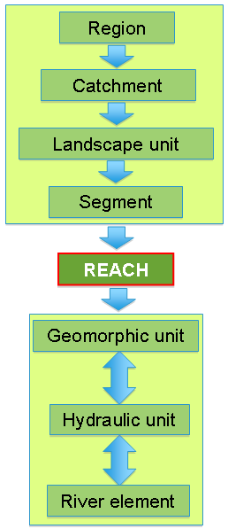
Why appropriate spatial scales need to be considered
A multiscale hierarchical approach fundamental for (i) understanding controls and off-site impacts, (ii) selecting monitoring sites; (iii) extrapolating information.
Key scale: river reach
PH: Physical habitat; RH: Riparian habitat; M: Morphological; HRA: Hydrological regime alteration.
(from Belletti et al., 2015)
Notes:
A multiscale hierarchical approach fundamental for (i) understanding controls and off-site impacts, (ii) selecting monitoring sites; (iii) extrapolating information.
Many existing assessment methods make use of a spatial scale (i.e., the site scale of a few 100 m) that is usually inadequate for the accurate diagnosis and interpretation of the causes of any morphological alteration. This is because physical site conditions commonly originate from processes and causes that operate at larger spatial scales.
The assessment of hydromorphological processes and alterations should be undertaken within an appropriate spatial hierarchical framework and scaling methodology, emphasizing relevant spatial units and temporal time scales, and identifying key controlling factors at each spatial scale as well as appropriate morphological indicators.
The reach is the key spatial scale for the assessment of hydromorphological conditions, where a reach is defined as a section of river along which boundary conditions are sufficiently uniform that the river maintains a near consistent internal set of process-form interactions.

Slide 5
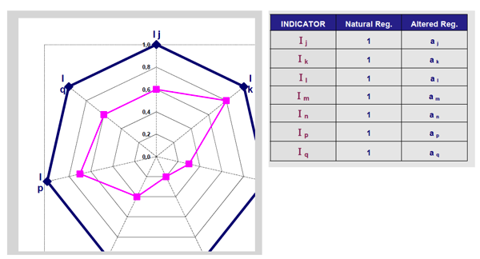
Hydrological assessment
Indicators of Hydrological Alteration (IHA) describing 5 flow components (magnitude, frequency, duration, timing, rate of change)
Hydrological alteration quantified as deviation between current and unaltered hydrological regime
IAHRIS: Polygons showing indicator values for reference and actual conditions
(from Martinez Santa-Maria & Fernandez Yuste, 2010)
Notes:
Hydrological assessment includes methods specifically used to assess the deviation of the hydrological regime from unaltered or previous conditions. Most of the methods used within Europe are based on some or all of the Indicators of Hydrologic Alteration (IHA). Indicators of Hydrological Alteration (IHA) describing 5 flow components (magnitude, frequency, duration, timing, rate of change). The output of these assessments is usually a synthetic index of the degree of deviation from unaltered conditions. Hydrological alteration quantified as deviation between current and unaltered hydrological regime.
The IARI (Indice di Alterazione del Regime Idrologico) and IAHRIS (Indices de Alteración Hidrológica en RIoS) are the two main examples of this category of methods. The values of each indicator are then represented in a polar diagram, where two polygons are generated: one representing the reference conditions, and the other representing the actual (altered) conditions. Hydrological alteration is calculated as the deviation in the areas of the two polygons, for each of the main component of the flow regime.
The main strength of such assessments is that they use robust indicators based on quantitative assessments, statistical analyses or physically-based models.

Slide 6
References
Belletti, B., Rinaldi, M., Gurnell, A.M., Buijse, A.D., Mosselman, E., 2015. A review of assessment methods for river hydromorphology. Environmental Earth Sciences, doi: 10.1007/s12665-014-3558-1.
Martinez Santa-Maria, C., Fernandez Yuste, J.A., 2010. IAHRIS 2.2. Indicators of Hydrologic Alteration in Rivers. Methodological Reference Manual & User’s Manual. http://www.ecogesfor.org/IAHRIS_es.html.

